Slide 1
Lecture 4 - Matrix Calculus Part 2
DS 4400: Machine Learning and Data Mining 1

Slide 2
Today
Today
Functions of ML Algorithms
Derivatives of High Dimensional Data
Examples Practice
The Regression Objective
Other Functions
Practice
Using autograd in Python

Slide 3
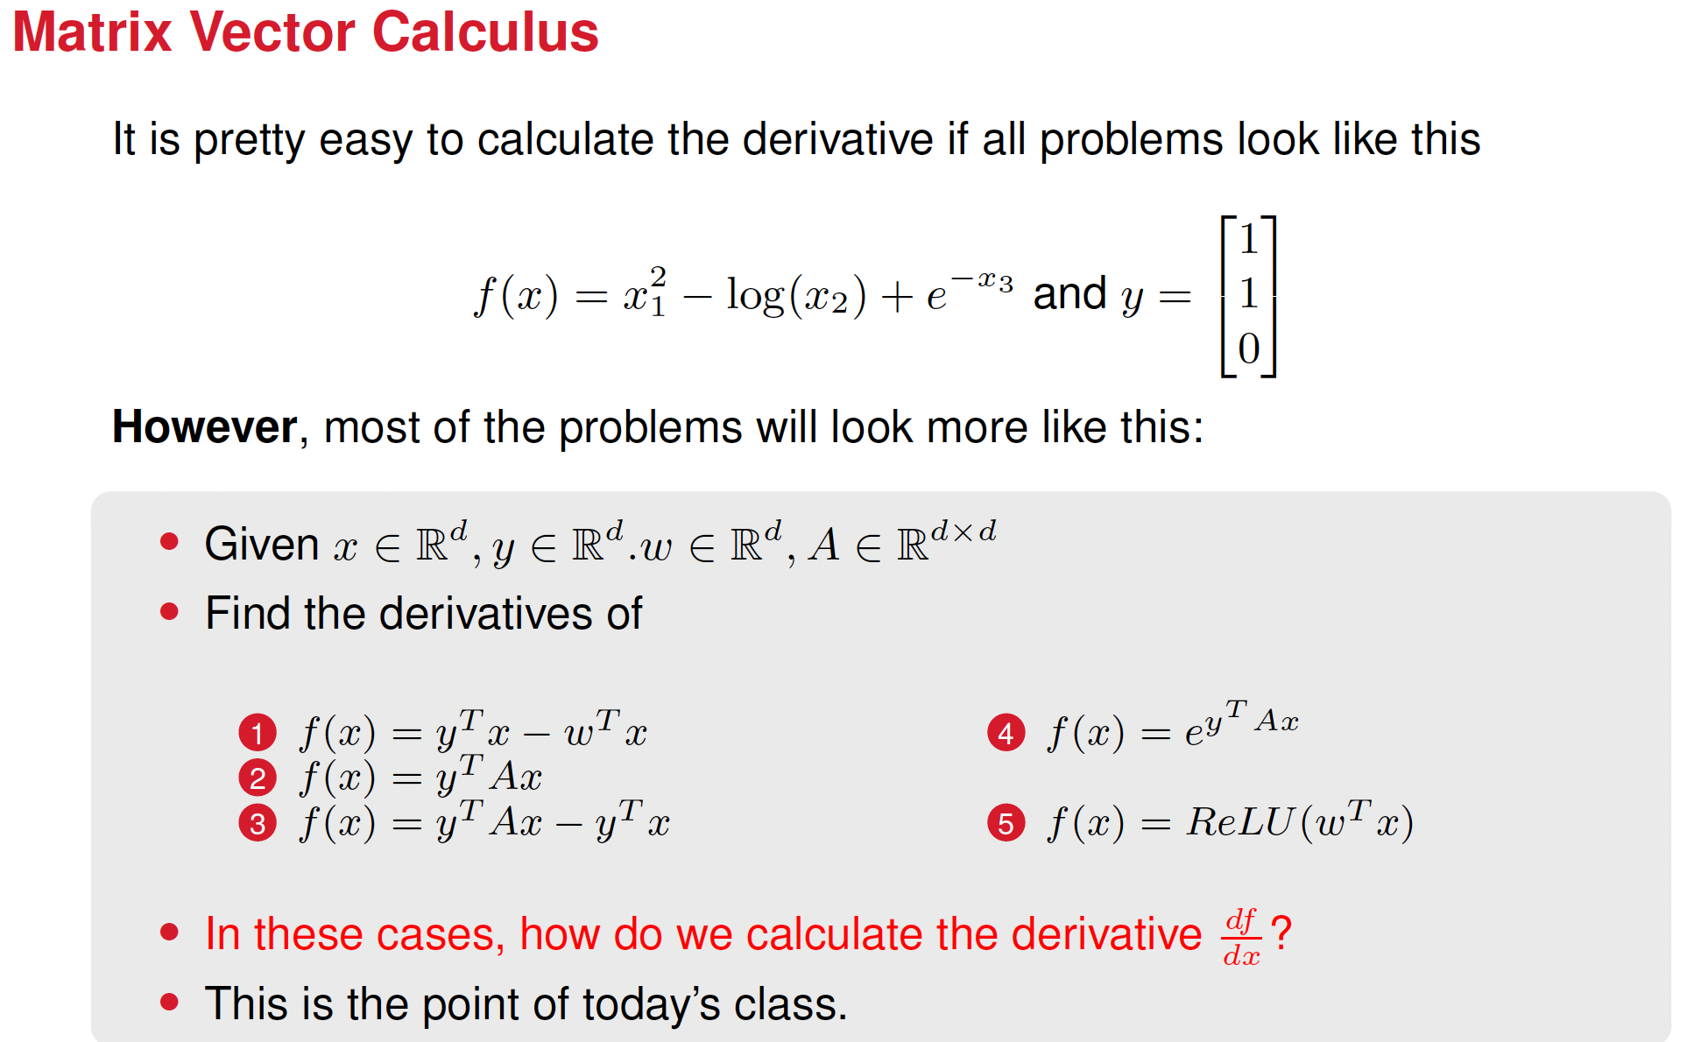

Slide 4
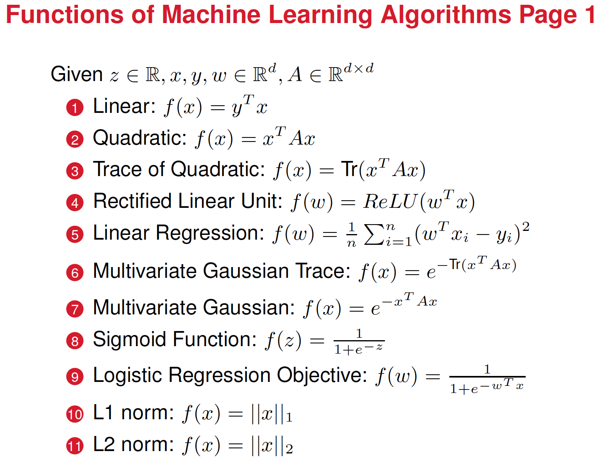



Slide 5
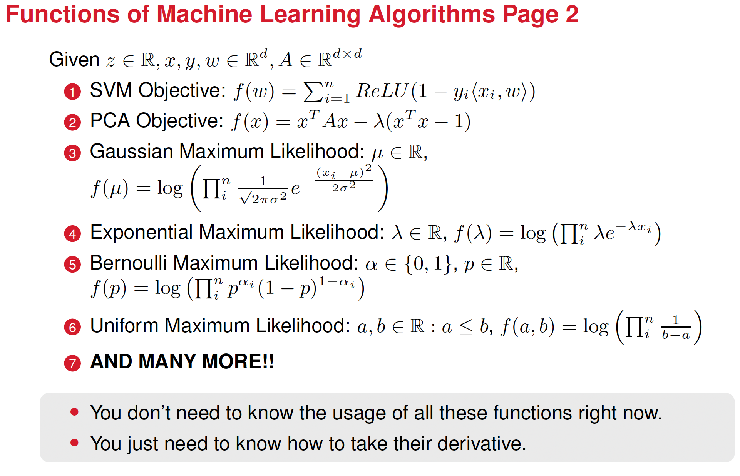

Slide 6
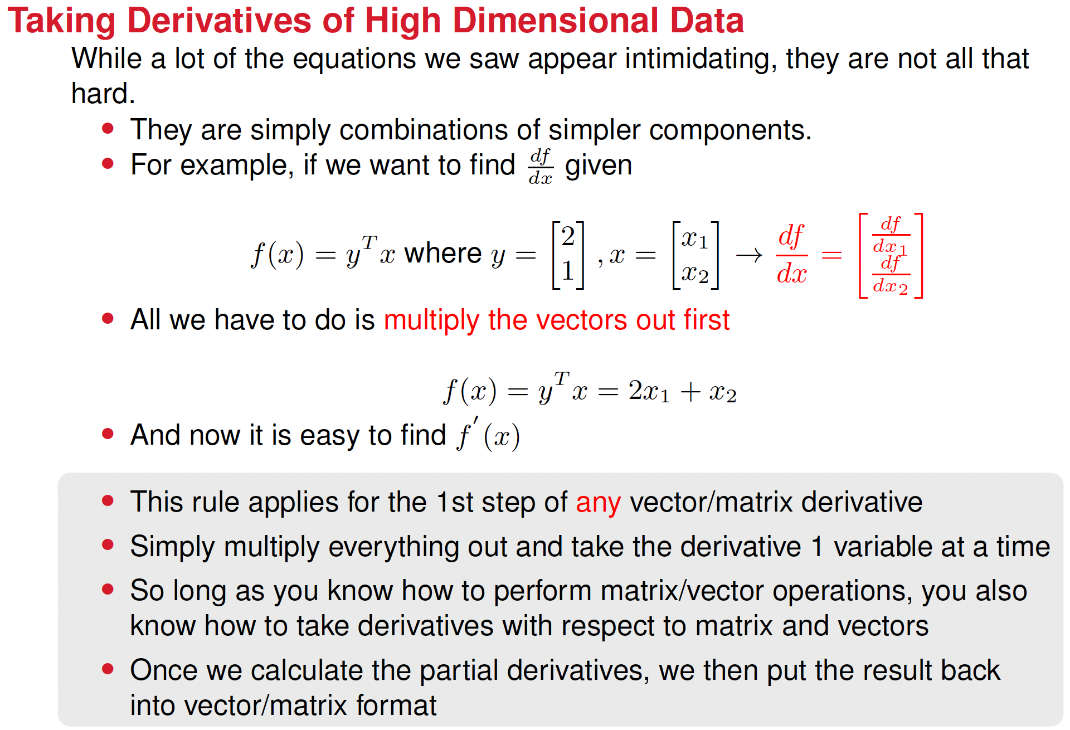

Slide 7








A few words about derivatives and partial derivates
Derivative:
If z = f(x), then the derivative of z with respect to x, is written as
Meaning of derivative: tell us how the function z changes when the variable x changes.
Partial derivative:
If z = f(x,y) then the partial derivative of z with respect to x, is written as
Meaning of partial derivative: tell us how the function z changes when one variable changes (x in the example above), while the other variable (y in the example above) remains constant.

Slide 8
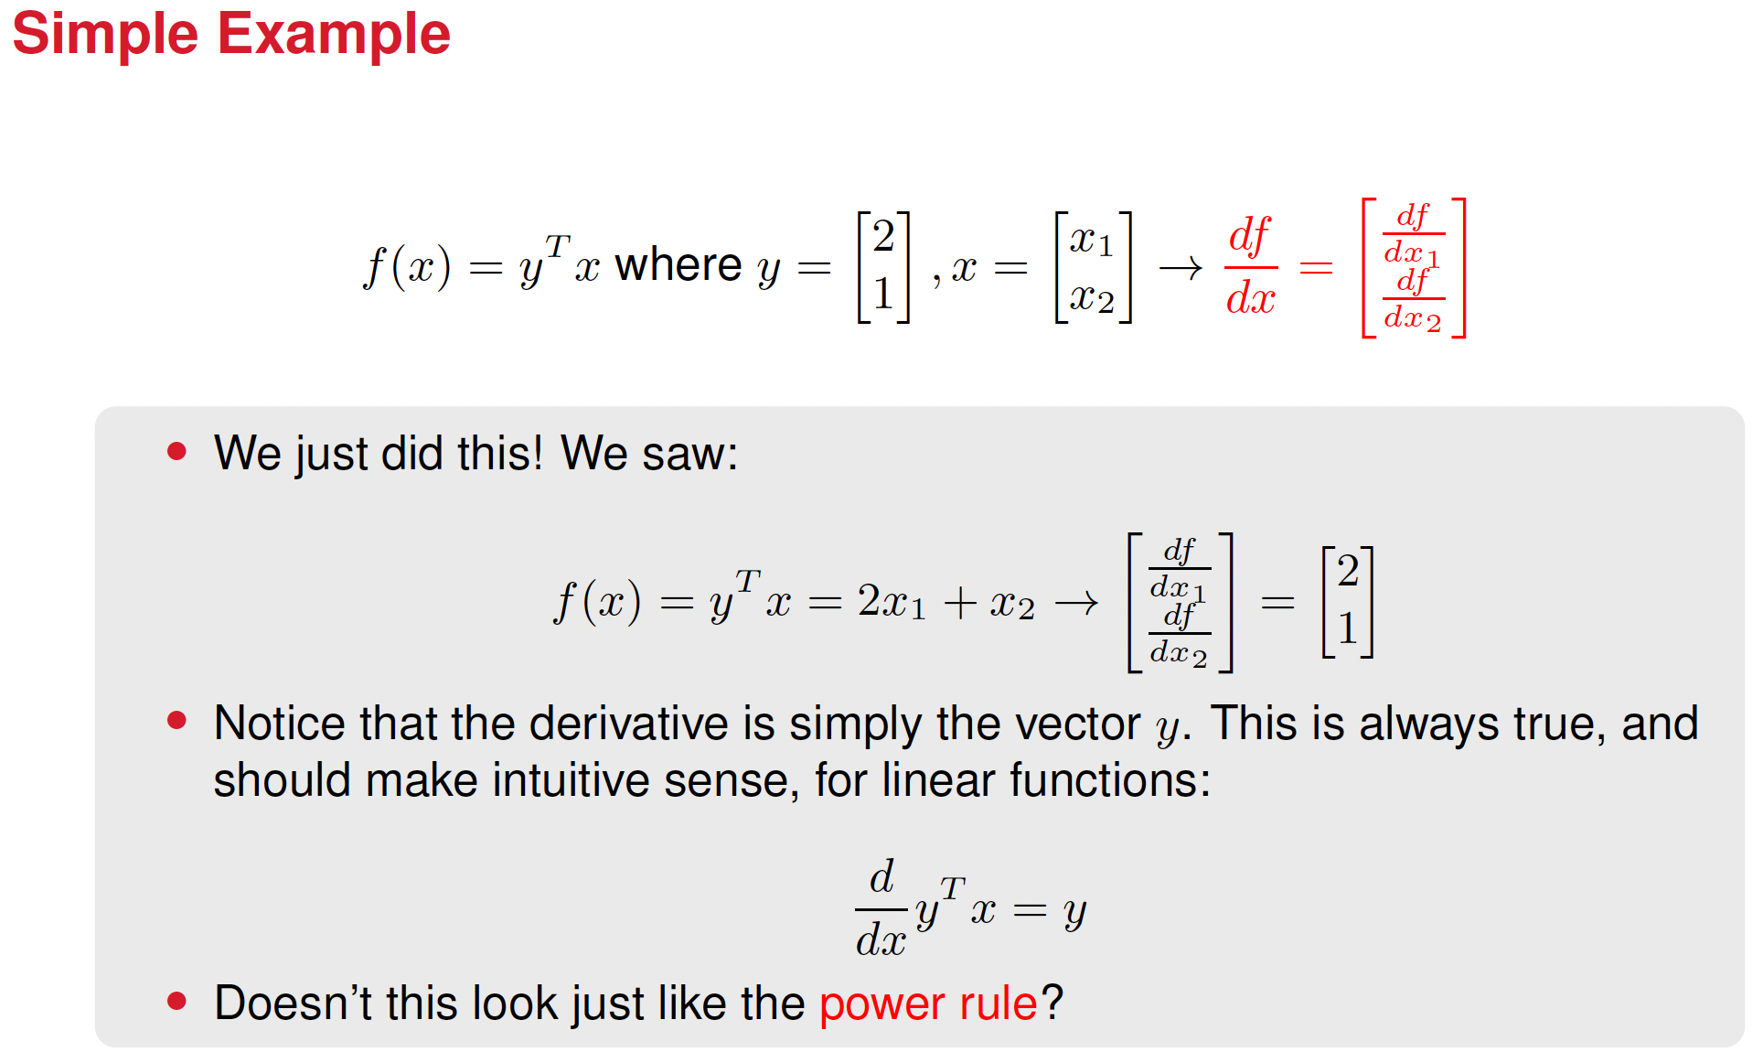

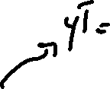











Slide 9
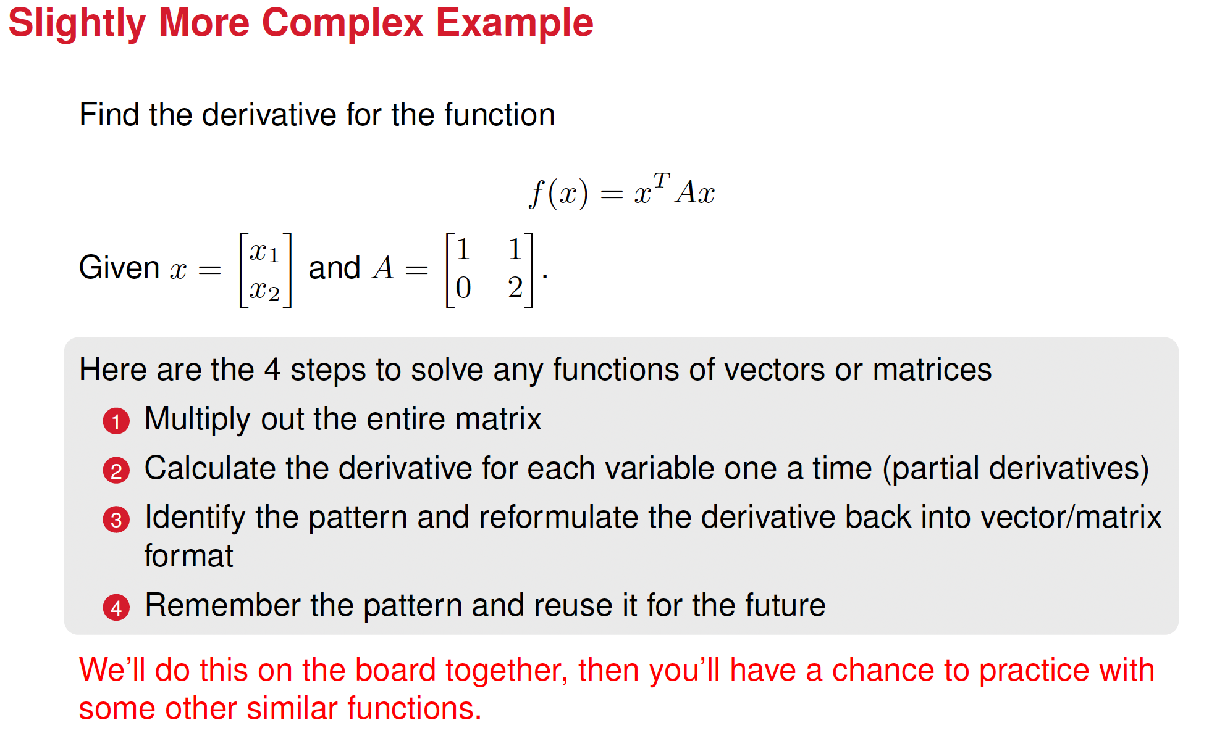

Slide 10




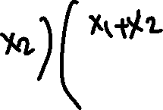


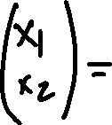
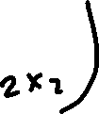

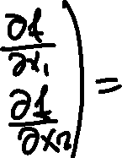





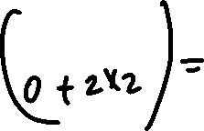


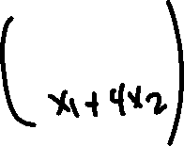





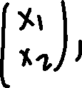
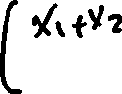
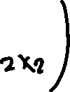





Slide 11
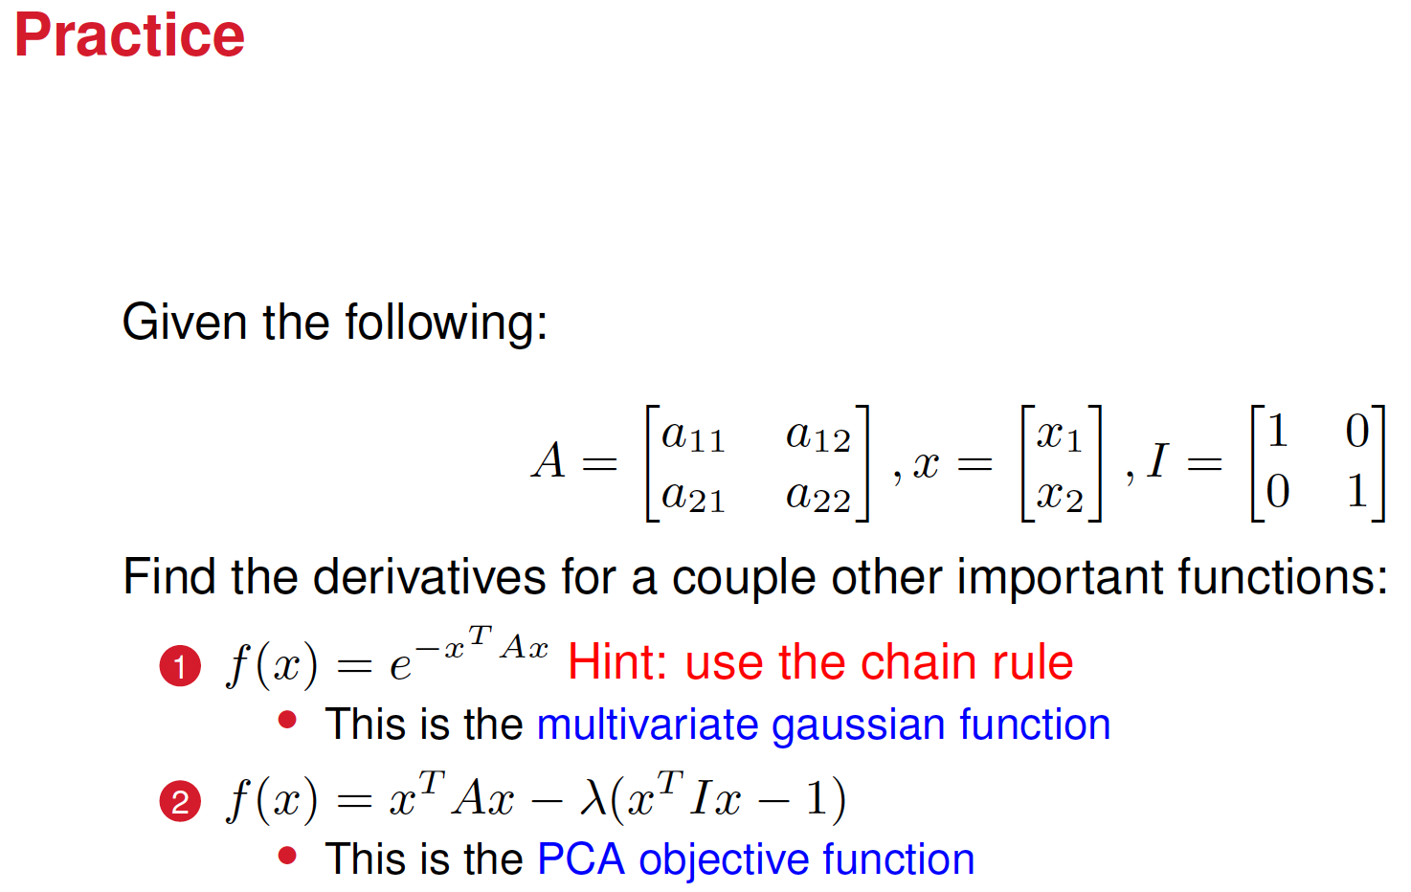

Slide 12






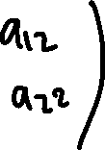




















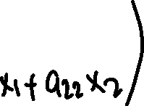
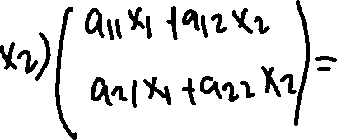






Slide 13








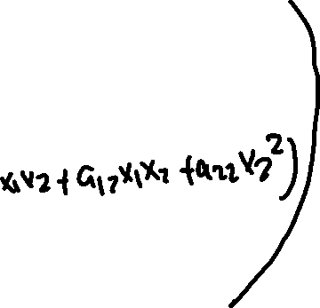





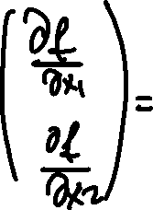









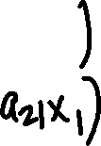


Slide 14
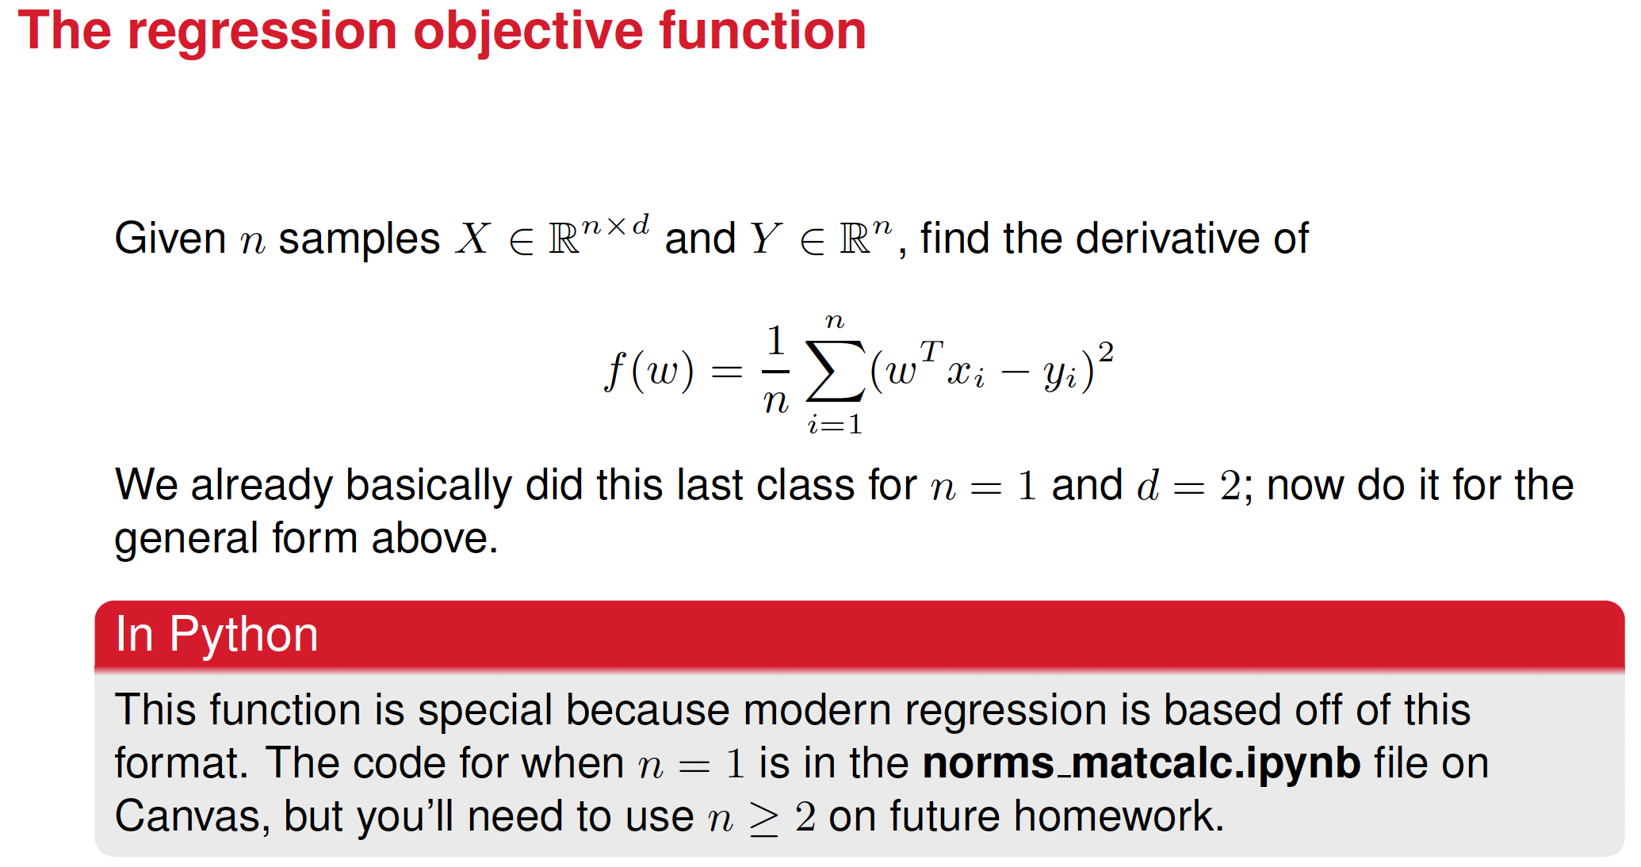

Slide 15
Before introducing more functions, let’s talk a bit about artificial neurons

Slide 16
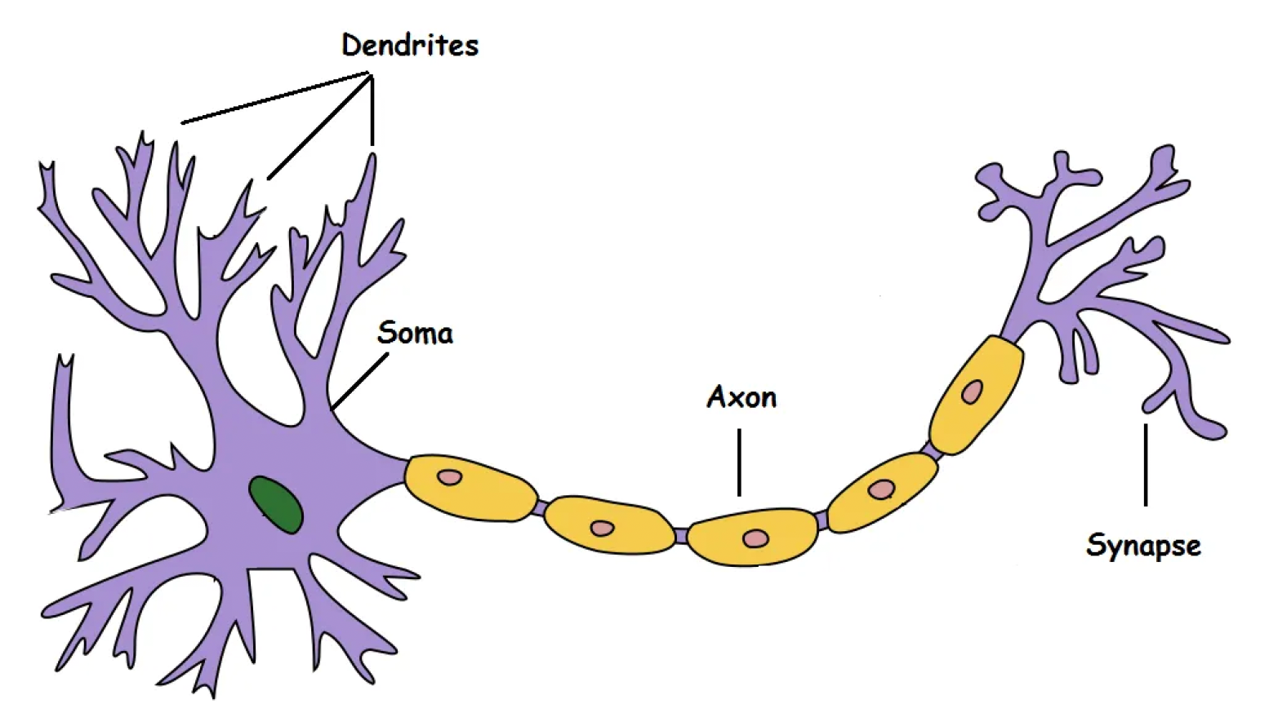
How a biological neuron works
Dendrites: take in information
Soma: processes the information
Axom: transmits the output
Synapse: connection to other neurons

Slide 17
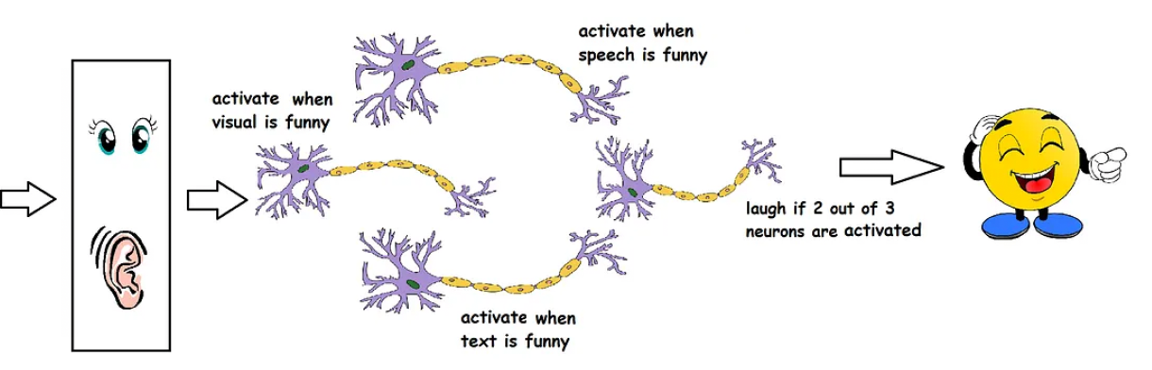

We can think the decision making process goes something like this
We are watching Shrek and might laugh or not depending on whether the neurons get activated/fired or not. Reality is more complicated: there are 10¹¹ (100 billion) neurons in our brain and their interconnection is not that simple

Slide 18
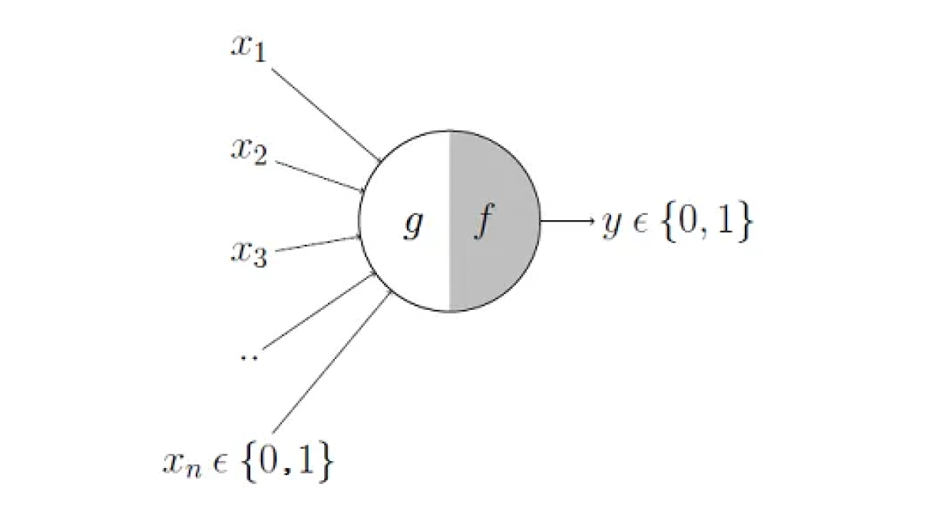
The McCulloch-Pitts (M-P) neuron
Artificial neuron proposed by Warren McCulloch (neuroscientist) and Walter Pitts (logician) in 1943.
g takes in several inputs
The inputs are aggregated
f makes a decision
The inputs and output are Boolean variables

Slide 19
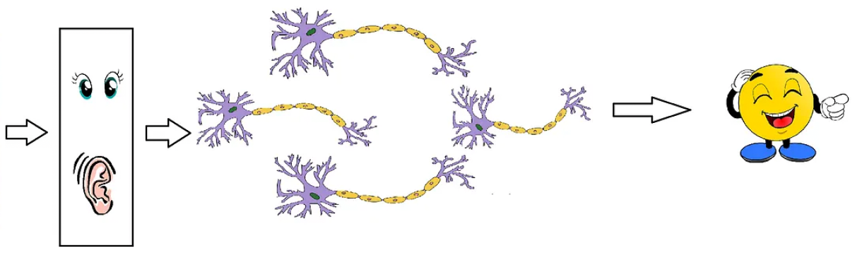




Making some variables x_{i} more important than others by adding weights, w_{i}

Slide 20
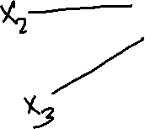





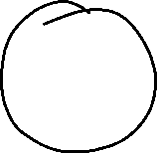
The Perceptron: the Minsky-Papert version of the M-P, which add weights
Includes numerical weights, W_{i}, which measures the importance of X_{i}
W_{i} can be learned (they can change)

Slide 21
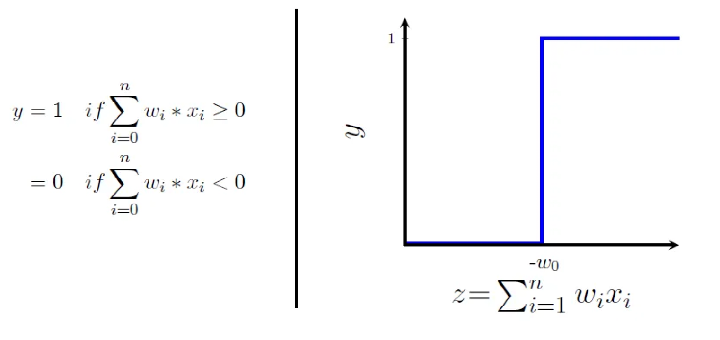
The Perceptron is activated with a step function, which is kind of harsh. There are other activation functions

Slide 22
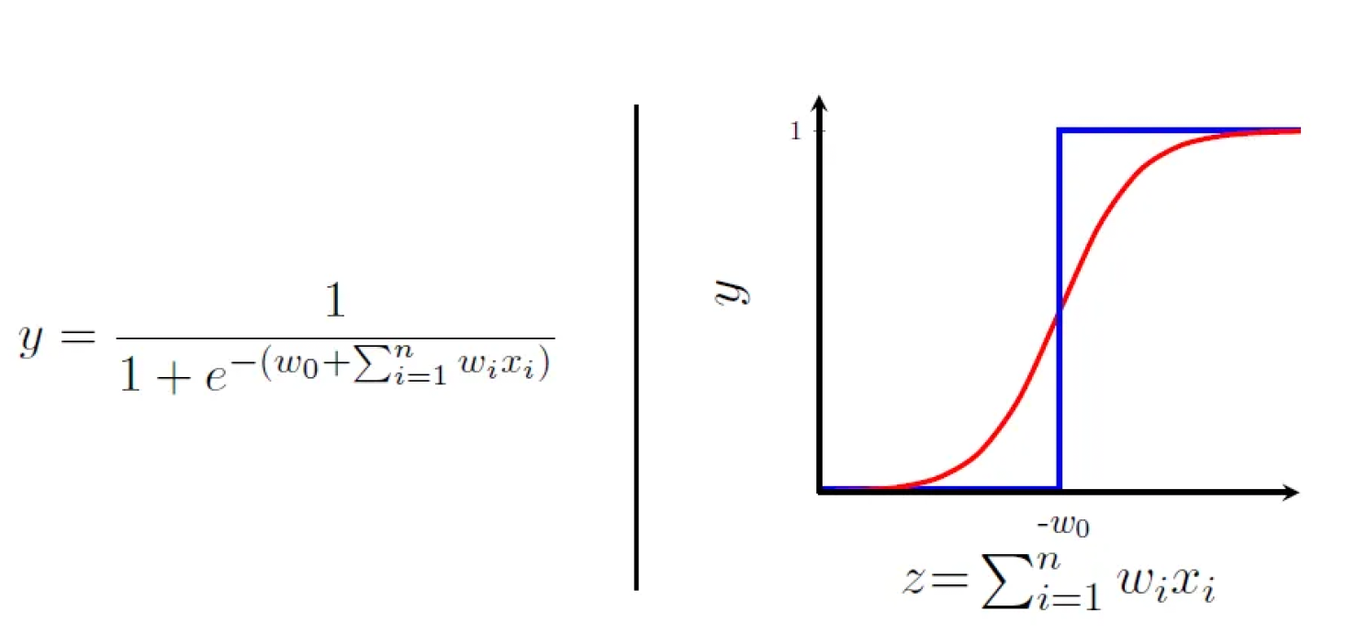
The logistic function
No sharp transition around w₀. The output is no longer binary but a real value between 0 and 1, which can be interpreted as a probability. Thus, instead of yes/no decision, we get the probability of yes. The output here is smooth, continuous and differentiable (this is important for neural networks -backpropagation

Slide 23
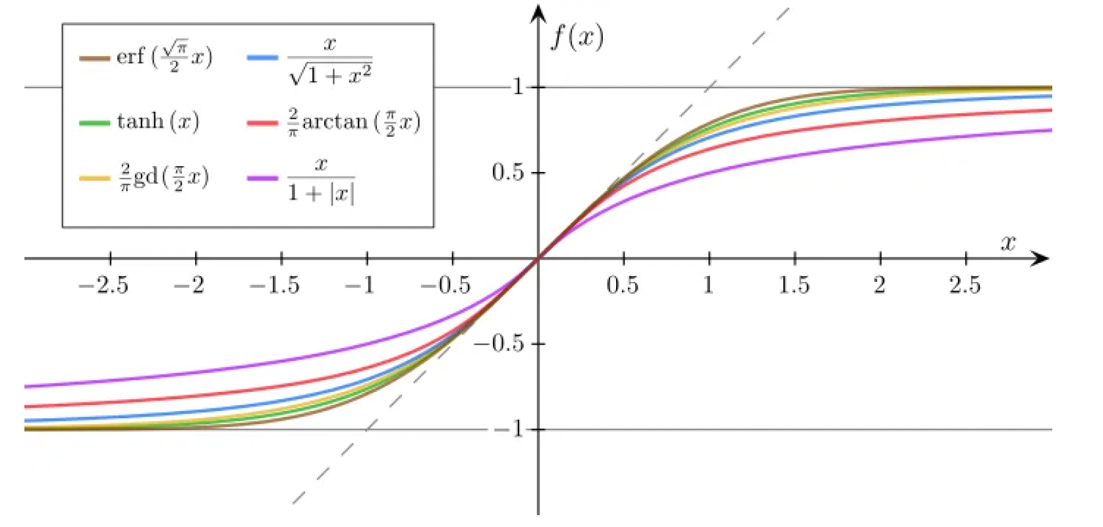
Different types of Sigmoid functions

Slide 24

Scary Smart: a brief comment on how robots learn vs. how we learn

Slide 25
In Scary Smart, Mo Gawdat tells the story of how robots learn.
Once a robot learns something, the other robots learnt the same immediately (the robot that first learn simply passes the software to the others).
This is different to how humans learn. It takes time for humans to transmit knowledge.

Slide 26

AI vs. our brain
https://www.youtube.com/watch?v=pPP5JpPP4sU

Slide 27
Different types of computers
Classical computers: use logic gates, CPUs, and GPUs
Quantum computers: exploit quantum mechanics for computation
Neuromorphic computers: mimic the structure and function of the human brain

Slide 28

ReLU and Sigmoid
Examples of activation functions
Next we look at their derivatives

Slide 29
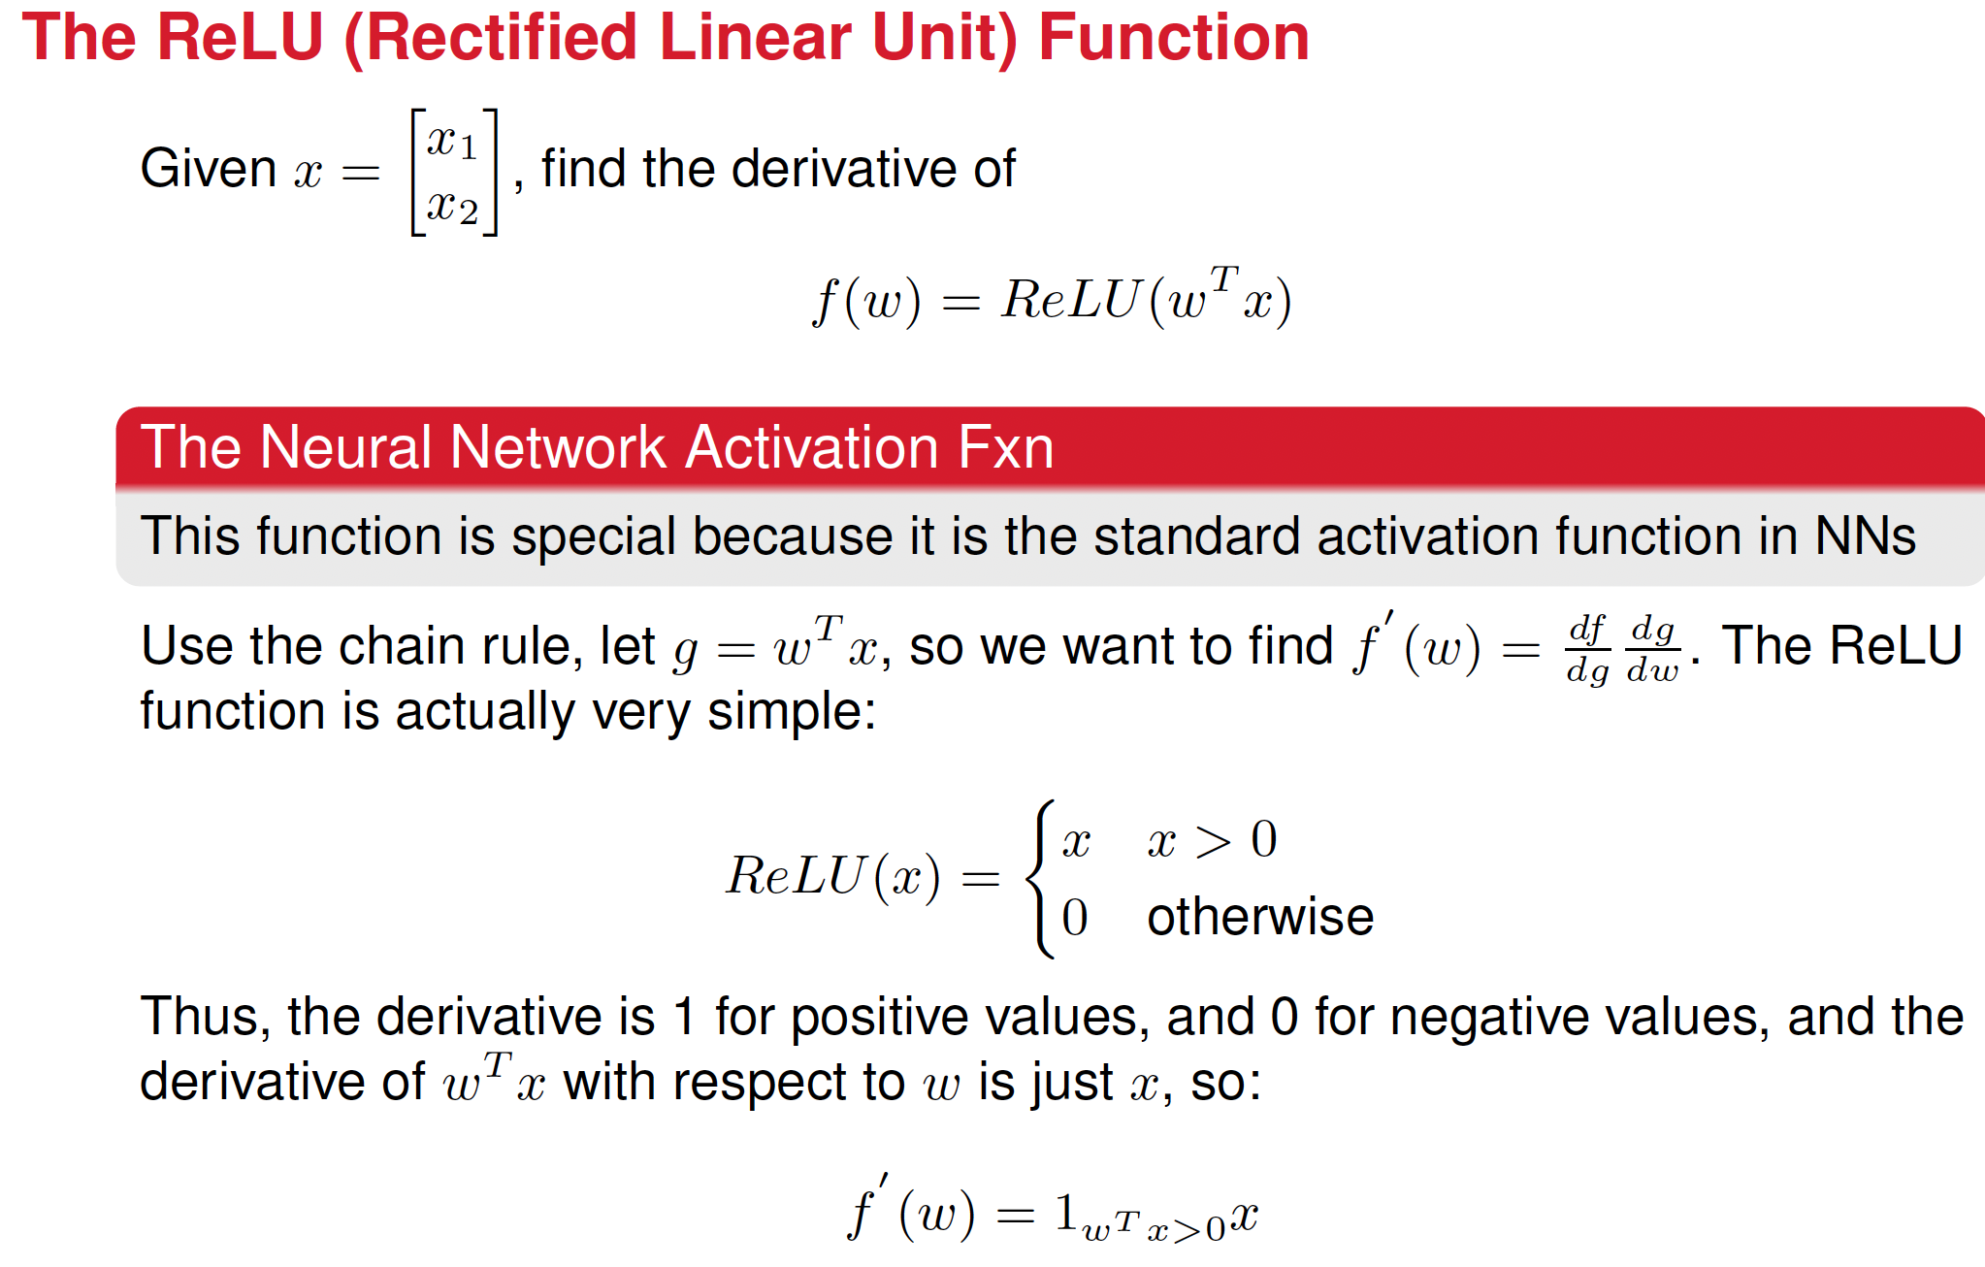

Slide 30
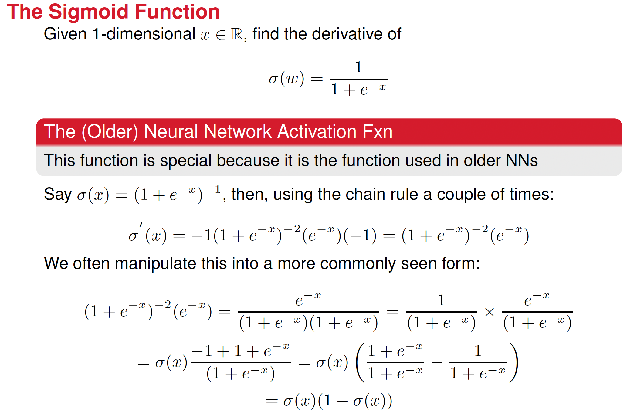


Slide 31
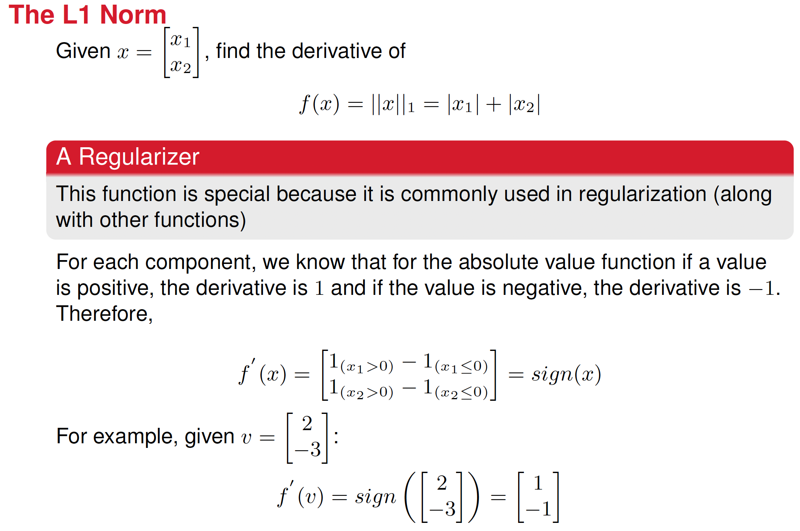

Slide 32
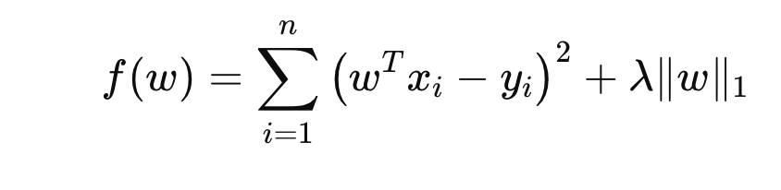
L1 regularization: We know that f(w) is the loss function for the regression model.
Question, what do you think the last term on f(w), the term that contains the norm, does to the loss function?
Clue: it’s a penalty. What type of penalty
L1 regularization promotes sparsity in the weight vector, which means it encourages models where many weights are set to exactly zero.

Slide 33
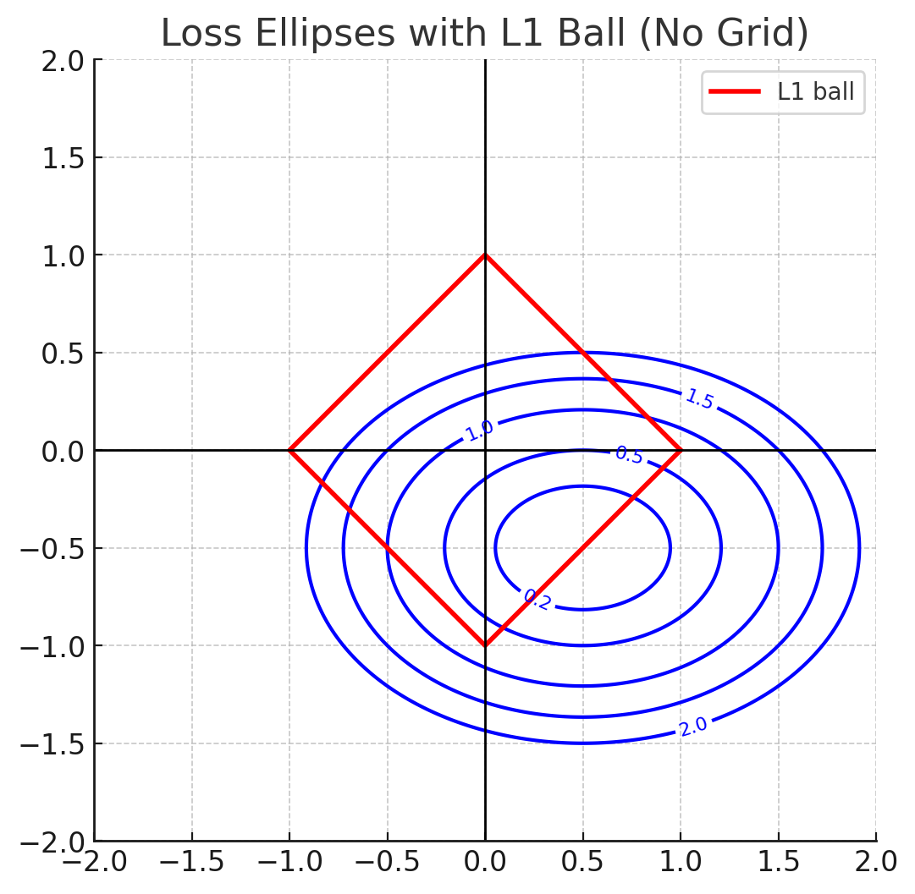
Geometrical interpretation of L1 regularization (Lasso)
Least Absolute Shrinkage and Selection Operator

Slide 34
Introduction to L1 Regularization
• L1 regularization adds a penalty equal to the sum of absolute values of the coefficients.
• Objective: Minimize loss + λ * ||w||₁.
• In 2D, the constraint region ||w||₁ ≤ t forms a diamond shape (L1 ball). t is a constant used to define the constraint

Slide 35
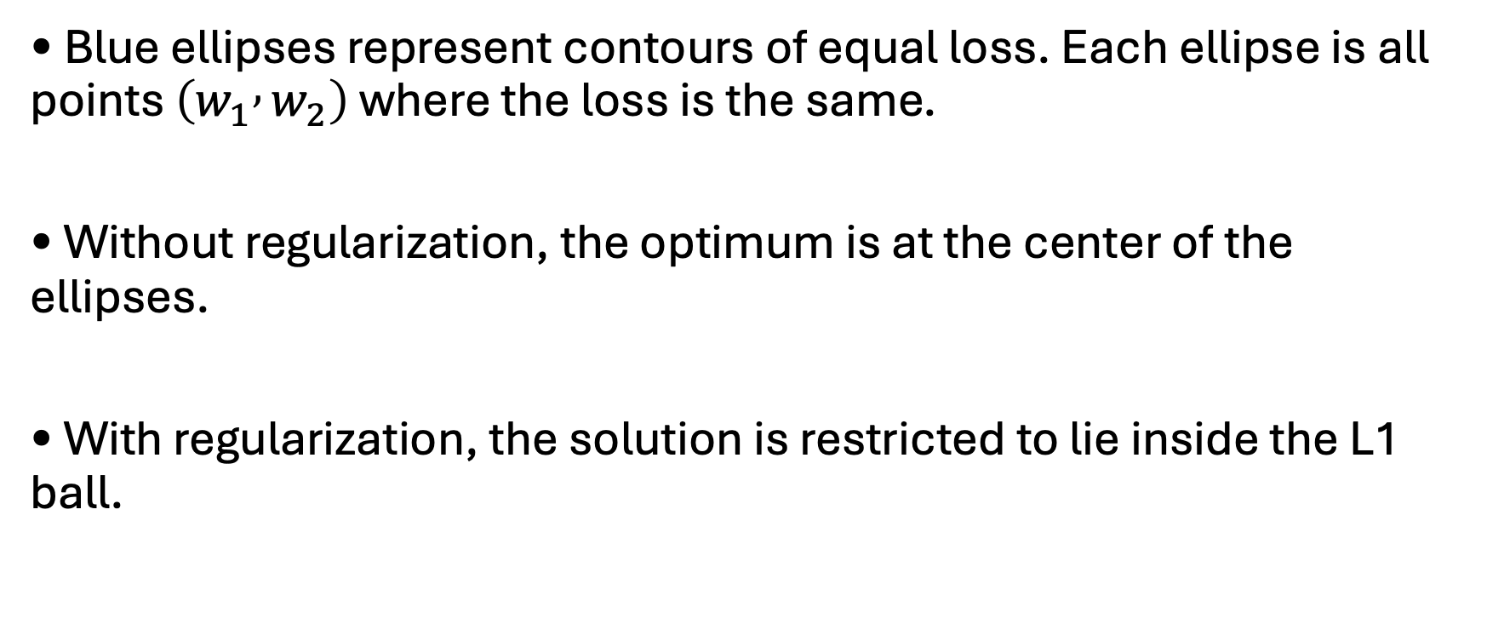
Loss Function Contours
• Blue ellipses represent contours of equal loss. Each ellipse is all points $\left(w_{1} , w_{2}\right)$ where the loss is the same.
• Without regularization, the optimum is at the center of the ellipses.
• With regularization, the solution is restricted to lie inside the L1 ball.

Slide 36
L1 Ball Constraint
• The L1 ball is defined by |w₁| + |w₂| ≤ t.
• In 2D, the L1 ball region is a diamond aligned with the axes.
• The idea is to search for the smallest loss contour that intersects the diamond.

Slide 37
Intersection Leads to Sparsity
• Shrink the loss contours until they first touch the L1 diamond.
• The first contact typically occurs at a corner of the diamond.
• Corners correspond to solutions where at least one coefficient is exactly zero.
• This explains why L1 regularization encourages sparse solutions.

Slide 38
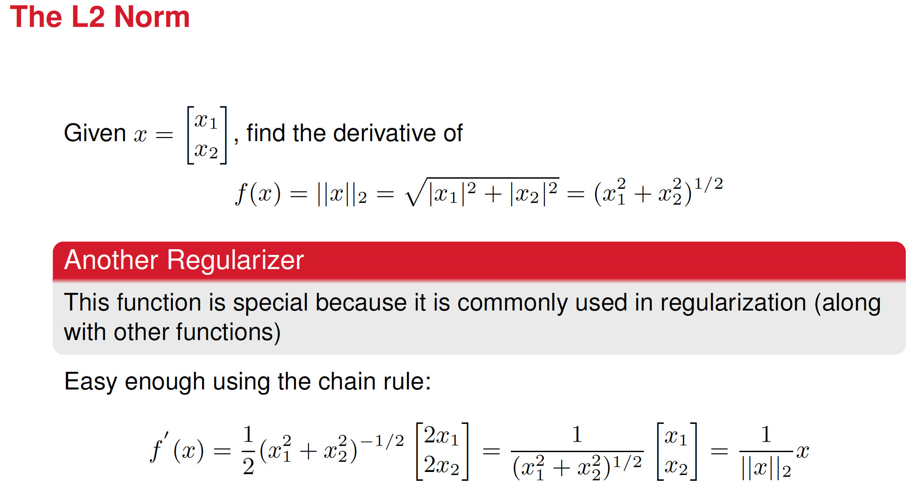

Slide 39
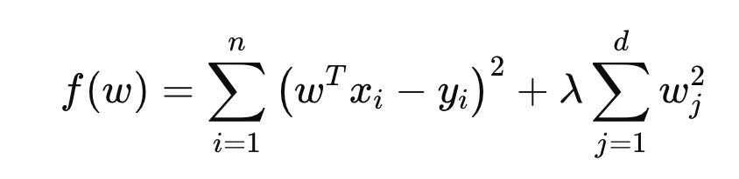
L2 regularization: We know that f(w) is the loss function for the regression model.
Question, what do you think the last term on f(w), the term that contains the norm, does to the loss function?
Clue: it’s a penalty. What type of penalty
L2 regularization applies a smooth, uniform shrinkage to all weights. Large weights are penalized more than smaller weights, but no weight is reduced to exactly zero

Slide 40
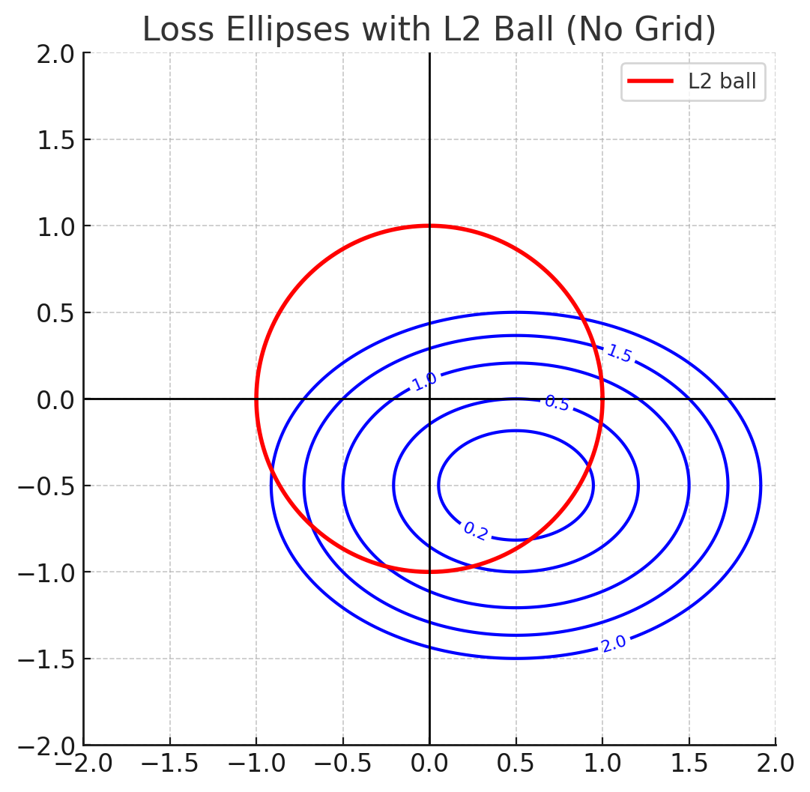
Geometrical interpretation of L2 regularization (Ridge)
https://www.tandfonline.com/doi/abs/10.1080/00401706.1970.10488635
https://www.tandfonline.com/doi/abs/10.1080/00401706.1970.10488634

Slide 41
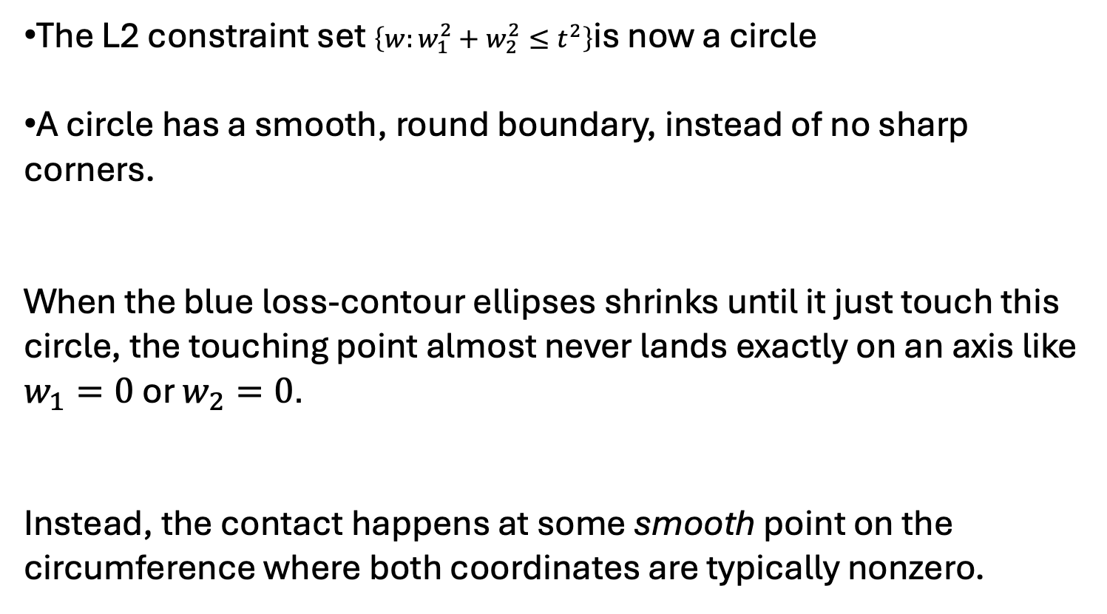
Introduction to L2 Regularization
The L2 constraint set $\left\{w:w_{1}^{2}+w_{2}^{2}≤t^{2}\right\}$is now a circle
A circle has a smooth, round boundary, instead of no sharp corners.
When the blue loss-contour ellipses shrinks until it just touch this circle, the touching point almost never lands exactly on an axis like $w_{1}=0$ or $w_{2}=0$.
Instead, the contact happens at some smooth point on the circumference where both coordinates are typically nonzero.

Slide 42
